Slide 1



Unified Mentor Private Limited
PPT on Basic Project
on
Chat Application
Name – Sanjay Vidya Pandit Domain – FullStack Web Development

Slide 2
Project Introduction :-
This project is a real-time chat application designed to enable seamless communication between multiple users over the internet. The main purpose of the project is to understand how real-time systems work and how frontend clients interact with a backend server. It focuses on implementing live messaging, user authentication, and data storage in a practical and scalable way.
The application allows users to sign up, log in, join chat rooms, and exchange messages instantly. It simulates real-world chat platforms while keeping the architecture simple enough for learning and experimentation.
The project was developed to strengthen knowledge of backend development, server-client communication, and database integration. It also helps in understanding how real-time events are handled efficiently.
Overall, this project serves as a hands-on learning experience in building interactive web applications with real-time capabilities.
Page 1

Slide 3
Tools Used & Methodology:-
The backend of the application is built using Node.js with Express.js to handle server-side logic and API routes. Express provides a lightweight and flexible framework for managing HTTP requests such as user signup, login, and message retrieval.
Socket.IO is used to enable real-time, bidirectional communication between the server and connected clients. This allows messages to be sent and received instantly without refreshing the page.
Firebase Firestore is used as the database to store user data and chat messages. Firestore was chosen because of its scalability, real-time data handling, and easy integration with Node.js.
The project follows a modular methodology where authentication, message handling, and real-time socket events are handled separately. This improves code readability and maintainability.
Testing was done by simulating multiple users joining chat rooms and exchanging messages to ensure proper synchronization and reliability.
Page 2

Slide 4
Result :-
The final application successfully supports real-time chatting with multiple users connected simultaneously. Users can create accounts, log in securely, and join chat rooms without conflicts.
Messages are delivered instantly to all users in the same room, creating a smooth and responsive chat experience. Chat history is stored in the database, allowing messages to persist even after users disconnect.
The system handles user join and leave events gracefully, displaying system messages to keep users informed.
Overall, the project meets its objectives by demonstrating a functional real-time communication system with proper backend support.
Page 3

Slide 5
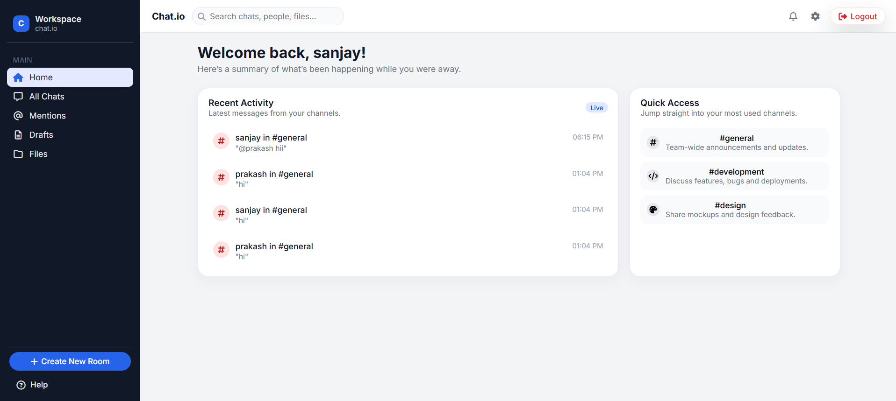
Page 4

Slide 6
Conclusion :-
This project demonstrates a clear understanding of real-time web application development and backend technologies. It highlights how Express, Socket.IO, and Firebase can work together to build efficient and interactive systems.
Through this project, valuable experience was gained in handling real-time data, managing user authentication, and structuring backend code effectively.
The application can be further enhanced by adding features such as message encryption, file sharing, typing indicators, and improved authentication security.
In conclusion, this project provides a strong foundation for advanced real-time applications and reflects practical skills in modern web development and system design.
Page 5

Slide 7


Thank you
Page 6

